Slide 1
AGS
McKinsey 7S Framework
(AGS Overview)

Slide 2
Table of Contents
Introduction to the McKinsey 7S Model
McKinsey 7S Framework Origin
The 7 Factors of the McKinsey 7S Model
Using McKinsey’s 7S Model for Change Management
McKinsey 7S Model Strengths and Weaknesses
Other Ways to Use McKinsey’s 7S Model
Conclusion

Slide 3
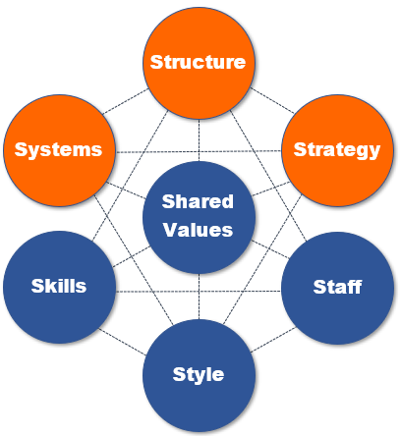
Introduction to the McKinsey 7S Model
The 7S model McKinsey developed takes a holistic look at what makes companies tick and how each element of a company needs to be in harmony for an organization to operate competitively and manage change successfully.
Tool
AGS

Slide 4
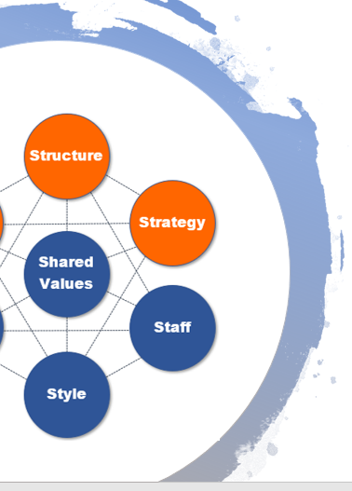
Rather than focus on a roadmap to change, the McKinsey 7S framework stresses that the coordination of seven critical components of a company are what’s most important in a change strategy.
Three factors are considered “hard elements” and four factors are considered “soft elements”.
• Shared Values (soft)
• Skills (soft)
• Staff (soft)
• Strategy (hard)
• Structure (hard)
• Style (soft)
• Systems (hard)
Hard Elements
Easy to Define
Formalized
Soft Elements
Attitudes
Workstyles

Slide 5
McKinsey 7S Framework Origin
The McKinsey 7S framework model was introduced in the late 1970’s by two former McKinsey consultants, Thomas J. Peters and Robert H. Waterman who featured it in the book In Search of Excellence.
Tool
AGS

Slide 6
After studying business strategy and success, Thomas Peters put forth the idea at the heart of the McKinsey 7S analysis: Companies were missing several key factors that helped their organizations run effectively because they were only focusing on strategy.
These factors, rather than having an order of importance, were all equally important.
Peters originally put forth his larger concept in a 700-slide, two-day presentation to a large corporation.
Of course, that long of a presentation wouldn’t work for all McKinsey clients, so the concept was condensed into the seven factors we find in McKinsey’s 7S framework for strategic management.
Knights of
the Roundtable
All 7 factors are equally important, just like the Knights of the Roundtable.

Slide 7
The 7 Factors of the McKinsey 7S Model
The McKinsey 7S framework provides you with several factors that need to be in alignment for your organization to be healthy and thrive. However, there is no specific order to address each element, you simply need to make sure they’re all addressed at some point in your project.
Tool
AGS

Slide 8
Shared Values
This is your corporate culture, belief system, and what you’re known for. What does your company want to achieve? What’s its mission? Its reputation?
If your company is known for being an innovator that blazes trails, do the processes you use also reflect that? If, for example, you are using antiquated systems to support your customer service activities, then your Systems factor would be out of balance with your Shared Values factor.
When it comes to applying McKinsey’s 7S framework in the strategic management of change, you want to ensure that your change project activities are reflecting your corporate culture and shared values.
Shared Values
Mission
Philosophy
Reputation
Achievements

Slide 9
Skills
This area of the McKinsey 7S model includes both organizational skills and individual employee skills.
You want to ensure that your team has the skills necessary to keep you competitive. And in the case of a change project, provide proper employee training to give your team the skills needed for the new process.
Another part of this factor in the McKinsey change management framework is to decide which skills should be kept in house and which ones would be more efficient as outsourced skills.
Skills
Employee
Organization
Outsourced

Slide 10
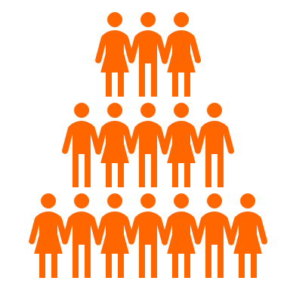
Staff
Your staff is another important element in the McKinsey 7S model. You have to ensure your staff is balanced and diverse, so you’ll have economies of scope.
Other important considerations are hiring practices, turnover, and staff policies that can help or hurt your business.
Example: If you’re a U.S. company expanding your operations to Singapore, the following would be Staff imbalances with other 7S factors of your business (Systems, Processes, Skills):
Hiring practices don’t include Singapore related job posting sites
No one on your team is familiar with the country
Phone systems don’t include local Singapore phone numbers
Staff
A stakeholder analysis at the start of a change project can help you understand staff needs.

Slide 11
Strategy
McKinsey describes strategy and organization as “two sides of the same coin.” Your strategy is how you plan to move your company toward its goals, while also remaining adaptive.
When it comes to a change project, the strategy element in the McKinsey 7S example would be the detailed plan or change management roadmap you follow to get from your current state to your desired future state.
This roadmap strategy needs to be in alignment with all the other 6 factors within the McKinsey 7S framework.
Strategy
How to move from Point A to Point B

Slide 12
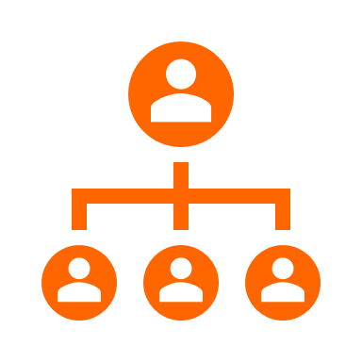
Structure
The structure element in the McKinsey 7S framework refers to your classic organizational structure or chain of command. These are also known as authority relationships.
Who needs to sign off on a change communication? Who should you alert if your timeline is changing?
If your organization’s structure is complex, the answer to those questions might not be clear to employees managing a change.
Structure
Reduce complexity
Define authority relationships

Slide 13
Style
Style is related to culture but is more about a personal managerial style or the culture a certain department might operate under. For example, some departments may be more open to outside ideas than others.
Style is one of the more difficult areas of the McKinsey 7S analysis to get on top of, because it’s very personal, and changing people’s managerial styles requires helping them become more self-aware.
This is where you will run into: “But that’s the way we do it around here” and similar types of attitudes that are resistant to change.
Having a resistance management strategy can help you bring this factor into balance with the others.
Style
Personal
Impacts staff
Can cause resistance
Can encourage support

Slide 14
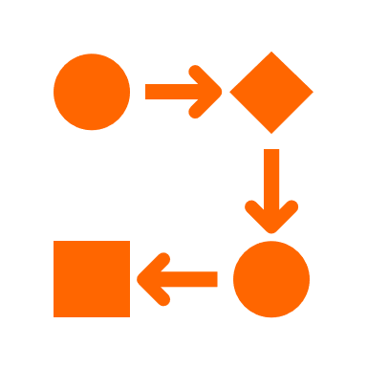
Systems
Systems refers both to the physical systems your team works with and the processes and workflows you have in place. What happens within your IT infrastructure after an order is placed at your company or how your HR department handles time-off requests are both systems.
You can think of the systems element of McKinsey’s 7S framework in strategic management as “how work gets done.”
When planning a change, you’ll want to ensure systems, including technology and processes, are aligned with the other six factors to drive efficiency and productivity.
Systems
“How work gets done”
Physical systems
Workflows
Processes

Slide 15
Using McKinsey’s 7S Model for Change Management
Because of the nature of the McKinsey 7S framework, it can be difficult to know where to start or how to use this model in a sequence needed for change management or company improvement. However, it can still be helpful for gauging balance during change projects.
Tool
AGS

Slide 16
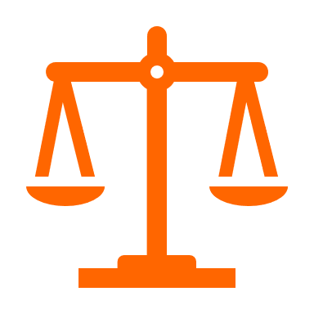
Steps for Using McKinsey 7S in Change Projects
Do an impact assessment to see how each of the seven factors in the McKinsey 7S model would be impacted by the change.
Create your change plan to address those impacts and with a goal to maintain balance.
Throughout your change project, check each of the seven factors to ensure each is being brought into a “post change” harmony, adjust strategy as needed.
Once your change project is complete, review each of the McKinsey 7S factors to ensure they’re in balance.
Balance
The purpose of the McKinsey model is to keep all 7 factors in balance.

Slide 17
McKinsey 7S Factor | Current State | Desired Future State | Need to Do This to Get There or Maintain Balance
Shared Values | Sustainability Team oriented Customer-Centric | Sustainability Team oriented Customer-Centric | Foster team connection using cloud Ensure phone system is cloud based
Skills | Proficient at current applications | Add proficiency in remote cloud programs Add new skills for remote working protocols | Establish training plan and evaluation method for new skills needed for remote workers
Staff | No one has worked remotely before | Have staff member with experience managing remote teams | Hire appropriate candidate with remote supervisory experience
Strategy | Current strategy is to serve customers as we have for 40+ years | Strategy that involves serving customers “anywhere, anyplace” | Develop a plan that includes marketing and processes to enable expansion of strategy to include remote teams.
Structure | Structure includes clear chain of command for onsite employees | Structure to be just as clear, but include chain of command for both remote and onsite employees | Review leadership/managers and come up with structure changes needed.
Style | Managers are used to having teams in the same building. | Managers treating onsite and remote employees the same as far as job duties, importance, promotions, etc. | Leadership training needed to indoctrinate managers and systems to support real-time communication for remote teams.
Systems | Workflows don’t currently involve remote employees, but are cloud-based; Technology supports remote teams. | Technology and workflows can be used seamlessly by onsite and remote teams. | Update any workflows needed and get feedback on processes to ensure they’re sufficient to support remote teams.
Example
Project
Moving from a fully onsite staff to 50% remote working staff

Slide 18
McKinsey’s 7S Model Strengths & Weaknesses
Is the McKinsey 7S model right for your change project? Some may find it flexible and holistic, while others may find it confusing and tedious.
Tool
AGS

Slide 19
McKinsey 7S Framework Advantages
It Can Be Applied Widely: The flexibility of the 7S model McKinsey promotes is one of its biggest strengths. It can be applied whether you’re going through change or to help identify weaknesses and opportunities in your organization.
It Takes a Holistic View: The framework by McKinsey is unique in that it focuses on harmony and balance within your organization. It helps companies to identity areas they may not see as connected and view them holistically when it comes to change.
People & Processes are Included: Some change management models focus heavily on people and others focus more on processes. The McKinsey model includes both, ensuring both the human and technical elements of change are kept in focus.
McKinsey 7S Pros
Flexible
Holistic
People + Processes

Slide 20
McKinsey 7S Framework Disadvantages
There is No Roadmap to Follow: A big drawback with the McKinsey 7S model is that it doesn’t give you steps or any roadmap to follow for a change management program.
It Can Be Tedious for Change Management: If you have to check every step of your change management process across each of the 7 S’s, you’d hardly have time to do anything else. Unless you have a small company and project, it can be tedious to use.
It’s Better as a Gauge Than a Strategy: The McKinsey 7S model is better when used as a gauge at the beginning and end of a change management project to ensure balance of the 7S areas of your organization. Using a different change management tool or model makes more sense for your actual change strategy and planning.
McKinsey 7S Cons
No Roadmap
Tedious to Use
A gauge, not strategy

Slide 21
Other Ways to Use McKinsey’s 7S Model
McKinsey’s framework in strategic management is a general methodology for checking that a business is in balance. It’s designed to be used for many different needs within an organization.
Tool
AGS

Slide 22
Other Ways to Use the McKinsey 7S Framework
The process of checking that each area of a company (the 7S factors) are in balance and harmony can be used to help a business beyond change management.
Here are some other ways it can be used:
Boost productivity and efficiency
Identify areas in a business holding the company back
Create a new business strategy
Align departments during mergers or acquisitions
Implement employee improvement strategies
Determine how to become more competitive
Uncover areas of opportunity
McKinsey 7S
Framework
A gauge to check organizational health & look for opportunities.

Slide 23
Conclusion
Final thoughts and conclusions regarding the McKinsey 7S Framework for organizational change and business management.
Tool
AGS

Slide 24
Conclusion: McKinsey 7S Framework
The McKinsey 7S framework is a powerful tool to look in depth at your organization and identify areas where it may not be operating in harmony. It offers a unique insight into seven key areas that other change models don’t explore in the same way.
The biggest problem with the 7S model is that it’s not well suited as a step-by-step strategy for change management. It’s much better when used as a gauge to “check the temperature” of your company.
It can be helpful to use alongside another change management model or tool to ensure your change project takes the 7S’s into consideration.
In general, it’s a helpful framework to gain deeper insight into the different moving parts of your organization.
Need Help with Change Management?
It’s what we do!
Email us any time with questions at:
support@airiodion.com

